Slide 1
Micflix
Sprint: 1
A netflix clone - by Mickey Krekels
Class: RB04

Slide 2
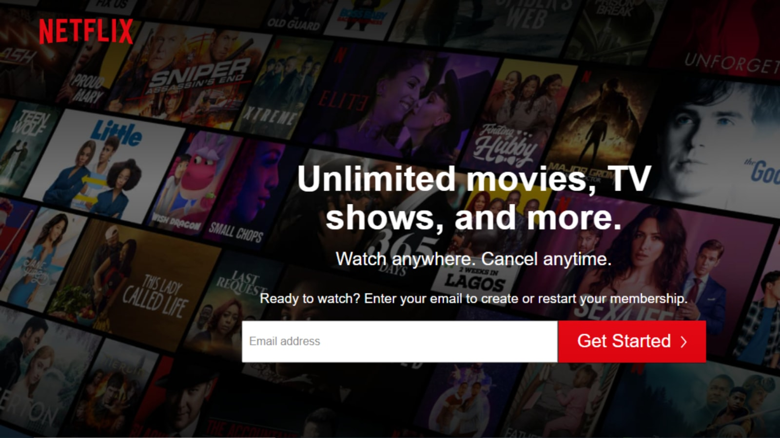
Introduction
Sprint goal
Achievements
Foundation Topics
Enterprise Architecture & Software Platforms
Architecture & Quality
Messaging & Security-by-Design
DevSecOps & Cloud Services
Next steps

Slide 3
Sprint goal
The main goal of sprint 1 was to set up a good basis on documentation, code and infrastructure.
The issues/stories created for the sprint were:
As a user, I should be able login to an account
As a user, I should be able to register an account
Create front-end prototype

Slide 4
ACHIEVEMENTS
First version User-service [Link]
Agile Enviroment with Jira [Link]
Repository on Github [Link]
DevOps enviroment with Portainer
CI/CD pipeline with Github-Actions and WatchTower
Documentation on Analysis and Technical Design

Slide 5
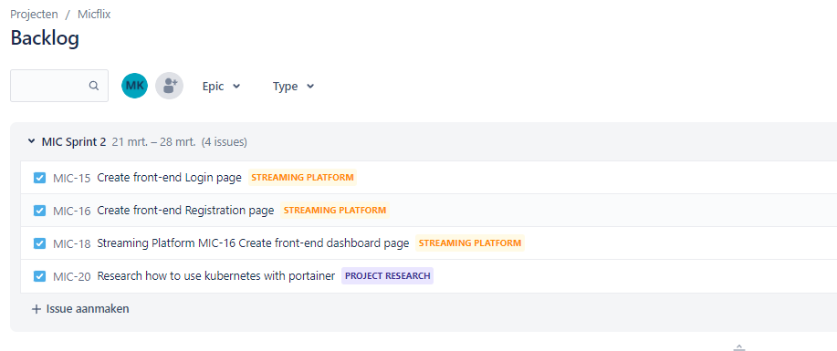
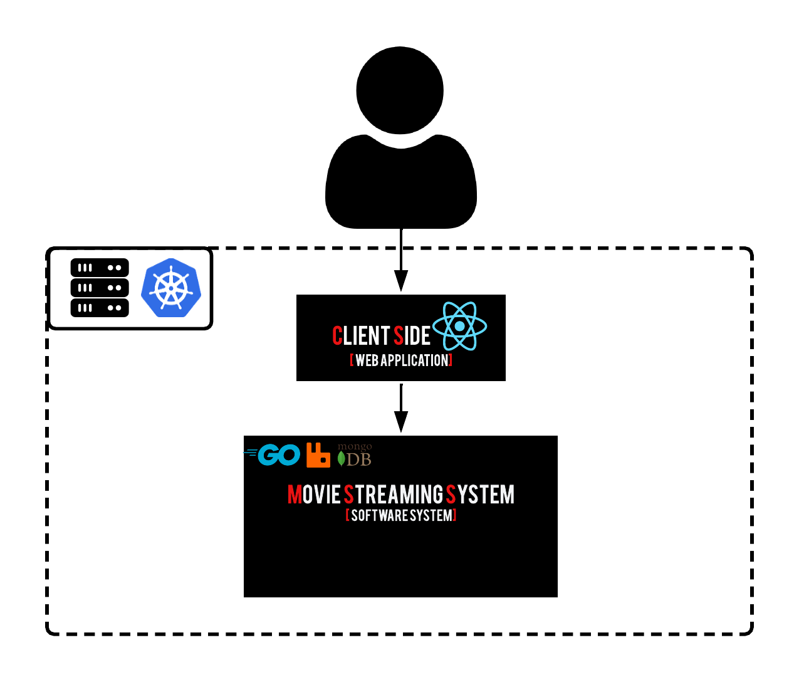
Enterprise Architecture & Software Platforms
Jira
Document on Analysis and Technical Design
Notes:
Enterprise applications (EA) are applications that are used in an enterprise context and are mainly used to satisfy the information management needs of an organization rather than individual users.

Slide 6
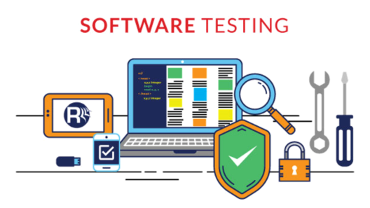
Architecture & Quality
CI/CD pipeline with Unit tests and Integration tests

Slide 7
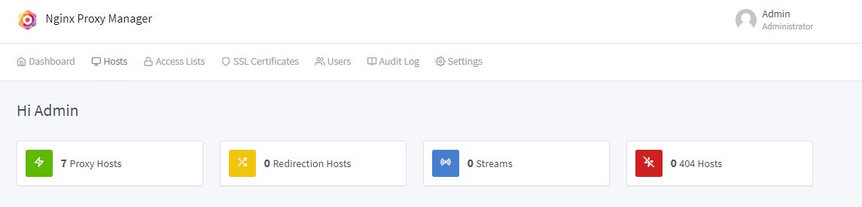
Messaging & Security-by-Design
Nginx Proxy Manager
SSL Certificates
- Testing with RabbitMQ and kubernetes

Slide 8
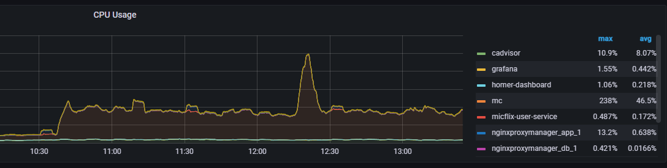
DevSecOps & Cloud Services
Docker environment with Portainer
Github-Actions and WatchTower
Monitoring with Grafana and Prometheus

Slide 9
Next steps
Focusing on the Streaming platform (front-end)
Creating a kubernetes environment with Portainer
Working on the DevOps document

